Slide 1
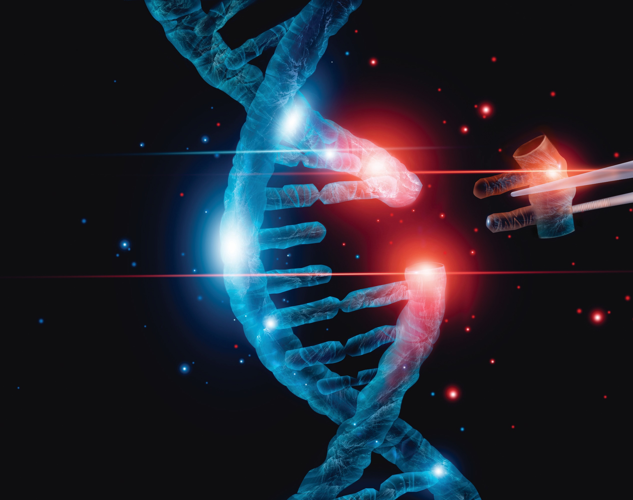
CAREERS IN GENE EDITING
NATALIA RIVERA-TORRES, PH.D.

Slide 2
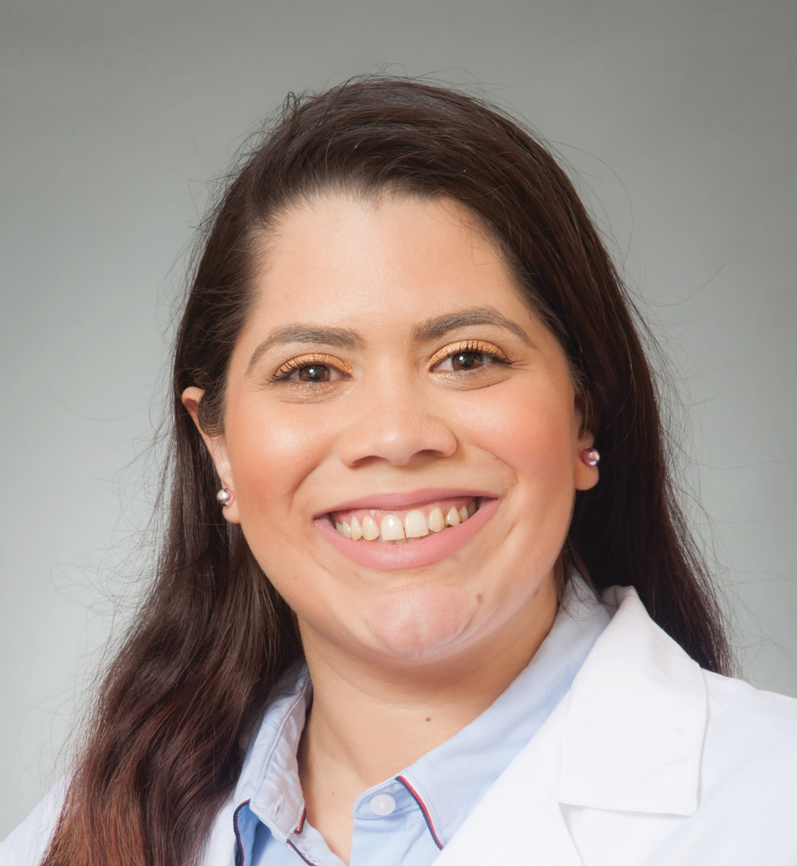
MEET NATALIA
Dr Natalia Rivera-Torres is a gene editor at the ChristianaCare Gene Editing Institute.
She is developing a platform for predicting gene editing outcomes in diverse patient populations with sickle cell anaemia.
Let’s learn more about her work…

Slide 3
Genes are units of deoxyribonucleic acid (DNA). They carry information that determines the features and characteristics that are passed down to you from your parents, such as the colour of your eyes or the texture of your hair. Each cell in the human body contains between 25,000 to 35,000 genes.
GENES ARE AMAZING!

Slide 4
This leads to a person inheriting health conditions and diseases. An example is sickle cell anaemia, which affects red blood cells. It is especially common in people with an African or Caribbean heritage. It means red blood cells cannot carry enough oxygen around the body, causing fatigue and shortness of breath. It is a serious and incurable condition. Treatment can help patients manage many of the symptoms.
GENES SOMETIMES CARRY AN ERROR IN THEIR DNA SEQUENCE

Slide 5
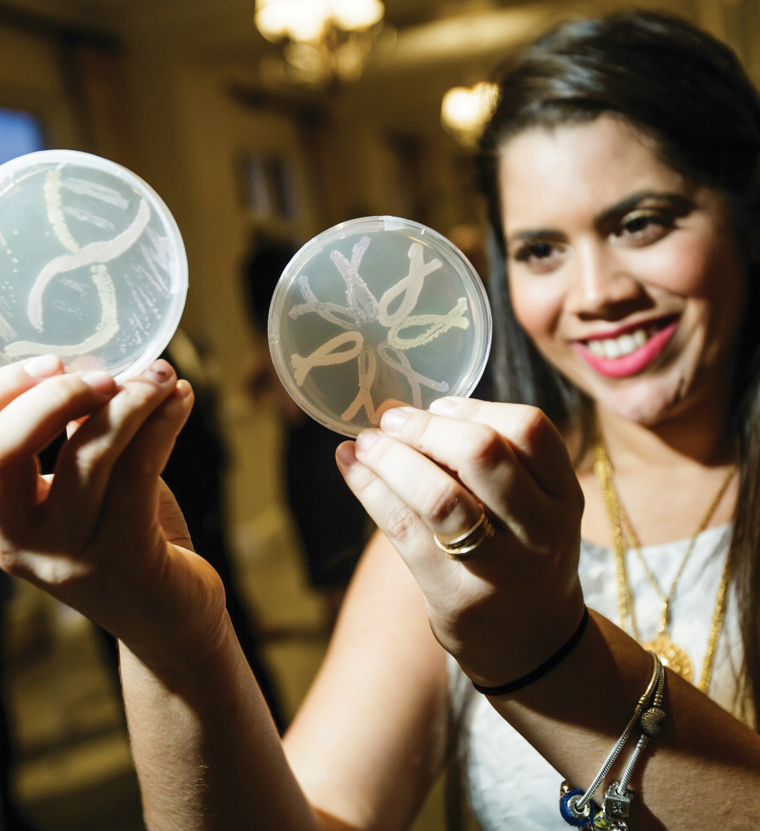
It is hoped that her work will lead to the ability to predict how each person’s blood stem cells will respond to gene editing to develop better treatments. Natalia and the team are working to identify the optimal CRISPR molecules that can provide a more universal response to sickle cell anaemia. The aim is to develop a prediction index that will determine the effectiveness of CRISPR-directed gene editing in individual patients.
WHAT IS THE AIM OF NATALIA’S RESEARCH?

Slide 6
CRISPR is a relatively new technology that can be used to edit genes. CRISPR enables scientists to find a specific part of DNA inside a cell, from where it can be altered. “Sickle cell disease is caused by a single mutation in the β-globin gene that results in hard distorted red blood cells with a sickle shape. This leads to diverse clinical manifestations with poor quality of life and early death,” explains Natalia. “CRISPR has opened the possibility of fixing the single mutation in a more controlled and efficient way than previous gene therapy technologies.”
WHAT IS CRISPR?

Slide 7
TALKING POINTS
What information do genes carry?
What is sickle cell anaemia and what causes it?
How do you think having sickle cell anaemia might affect someone’s day to day life?
What is CRISPR?
How is Natalia using CRISPR to address sickle cell anaemia?

Slide 8
The first and most unique step in Natalia’s research is the preparation of cell-free extracts from healthy donors or sickle cell patients. “By making these extracts, I can test each individual’s response to gene editing outside of the cells,” says Natalia. “Being able to produce cell-free extracts from blood stem cells to test gene editing outside of a cell, with similar outcomes to ones observed inside the cell, is a significant step forward.”
THE FIRST STEP

Slide 9
Predicting and understanding patient population genetic variations on gene editing outcomes will lead to better and more precise universal treatments. This could lead to substantial improvements in the health and quality of life for sickle cell patients, as edited cells have been found to produce normal, functioning haemoglobin. Achieving this is at the forefront of alleviating patient distress, so the outlook is good.
HOW COULD NATALIA’S RESEARCH
IMPACT LIVES?

Slide 10
TALKING POINTS
What is the first step in Natalia’s work and what will it enable her to test?
What impact could Natalia’s research have?
What do you think motivates Natalia to do the work she does?
What challenges do you think Natalia faces in her work?
How well would you cope with such challenges? What skills would enable you to meet them?

Slide 11
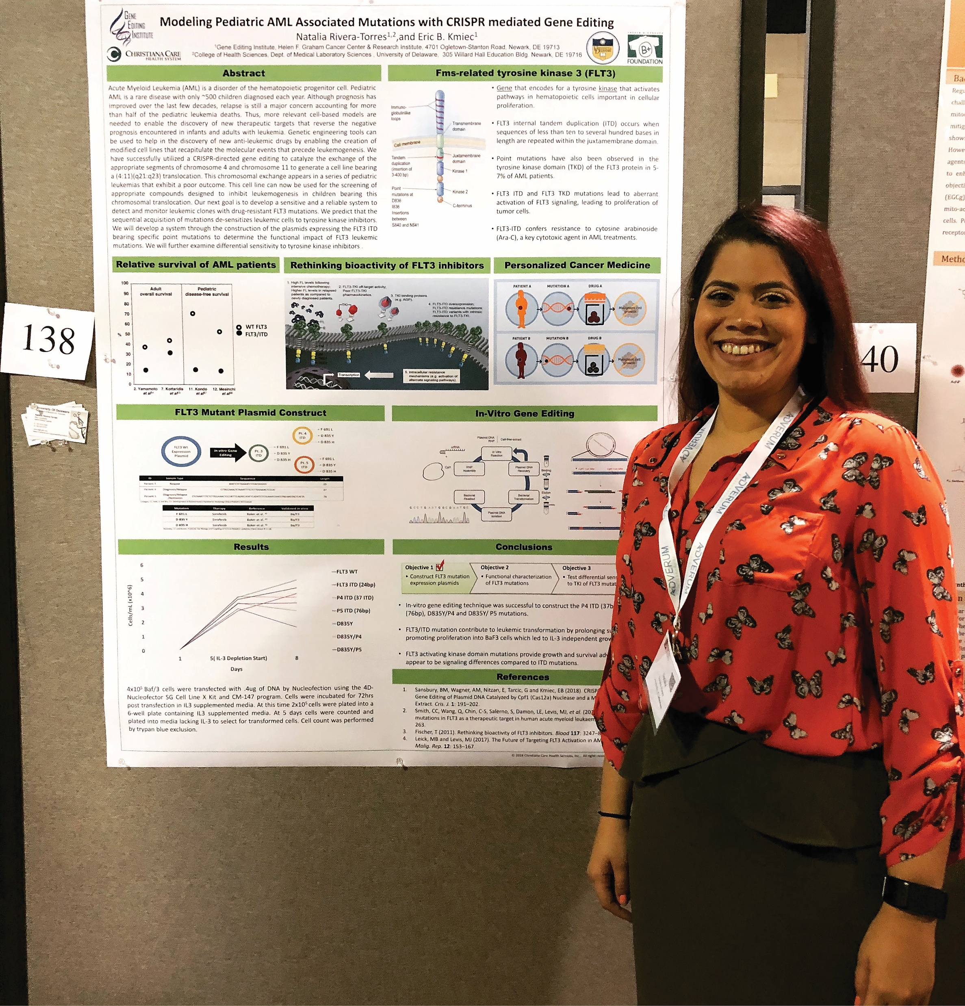
HOW CAN YOU BECOME A GENE EDITOR?
The Genetics Society of America is the professional membership organisation for scientific researchers and educators in genetics and an important resource for those interested.
CRISPR/Cas9 is a specific, efficient and versatile gene-editing technology. Put simply, it is advancing the field and it is essential you learn about it.
Your average salary could range anywhere between $24,000 and $80,000, depending on your level of experience.

Slide 12
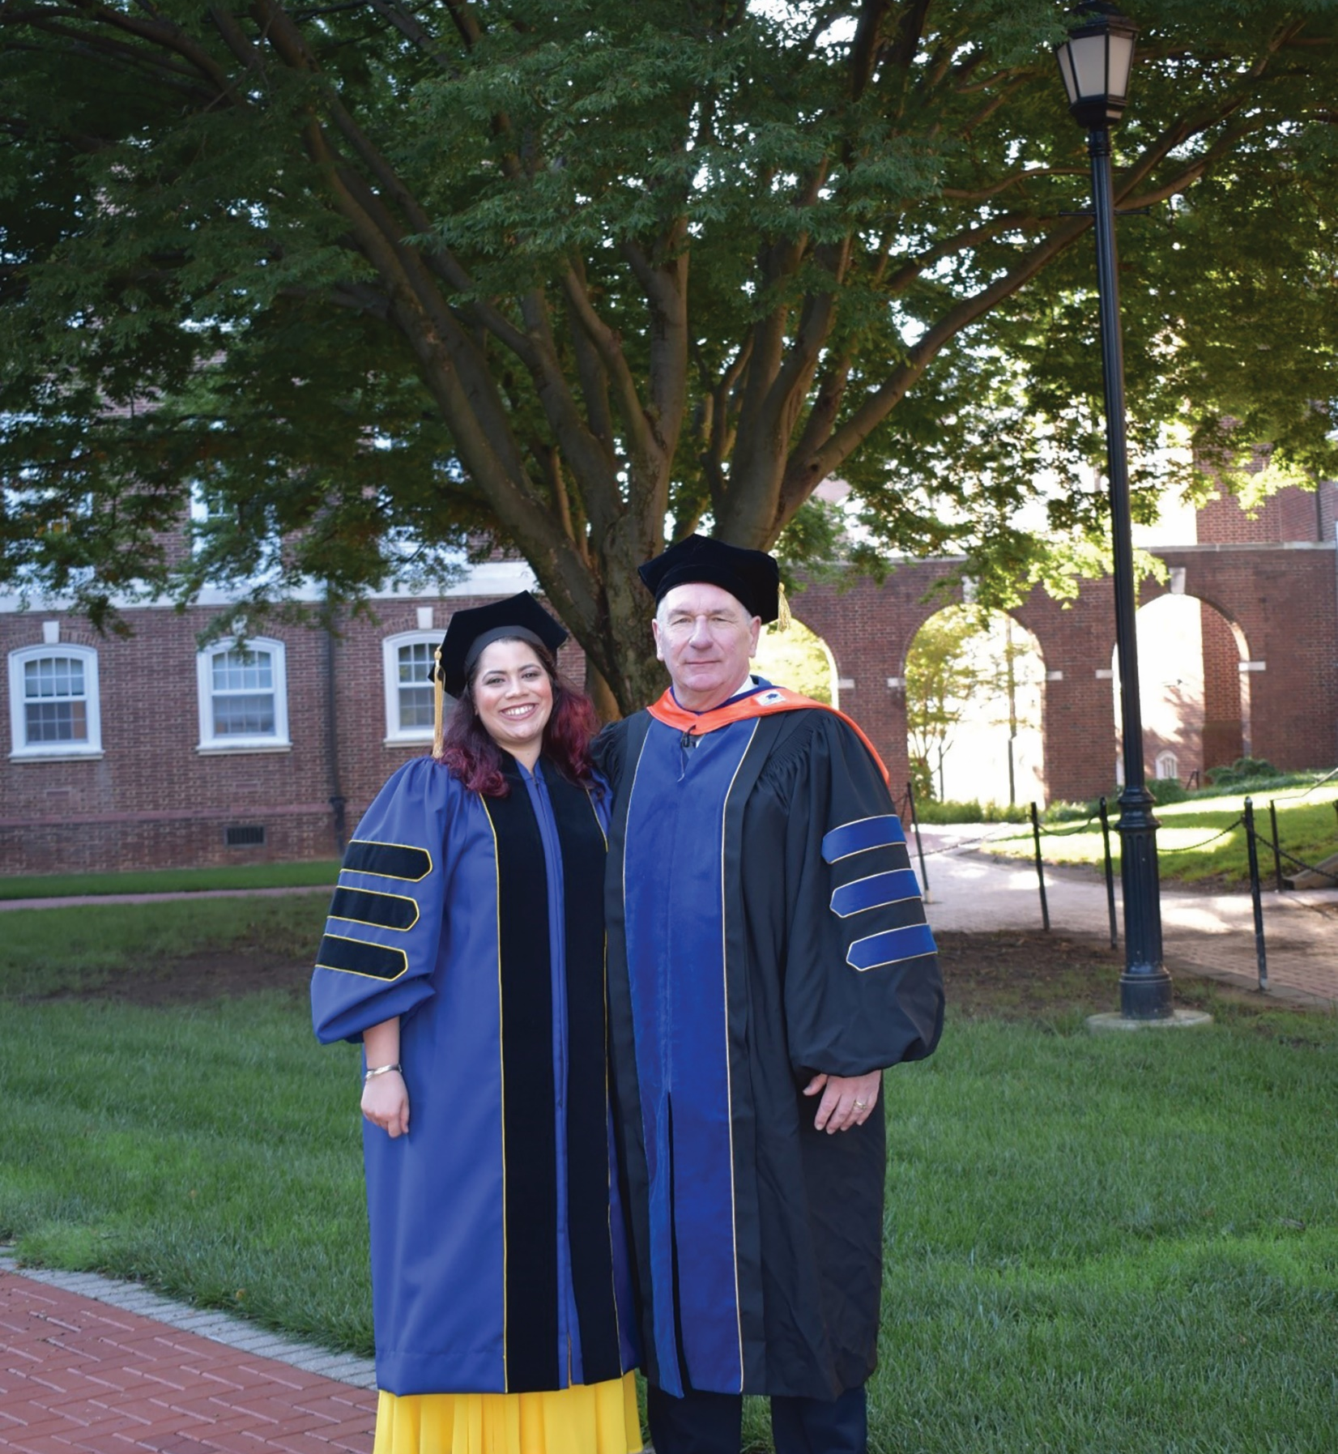
PATHWAY FROM SCHOOL TO GENE EDITING
Natalia says that while there are multiple routes into gene editing, some subjects you might want to consider taking are biology, genetics, molecular and cellular biology, molecule genetics and biochemistry.
You will need a degree in a relevant subject for postgraduate study.
Explore the National Careers Service

Slide 13
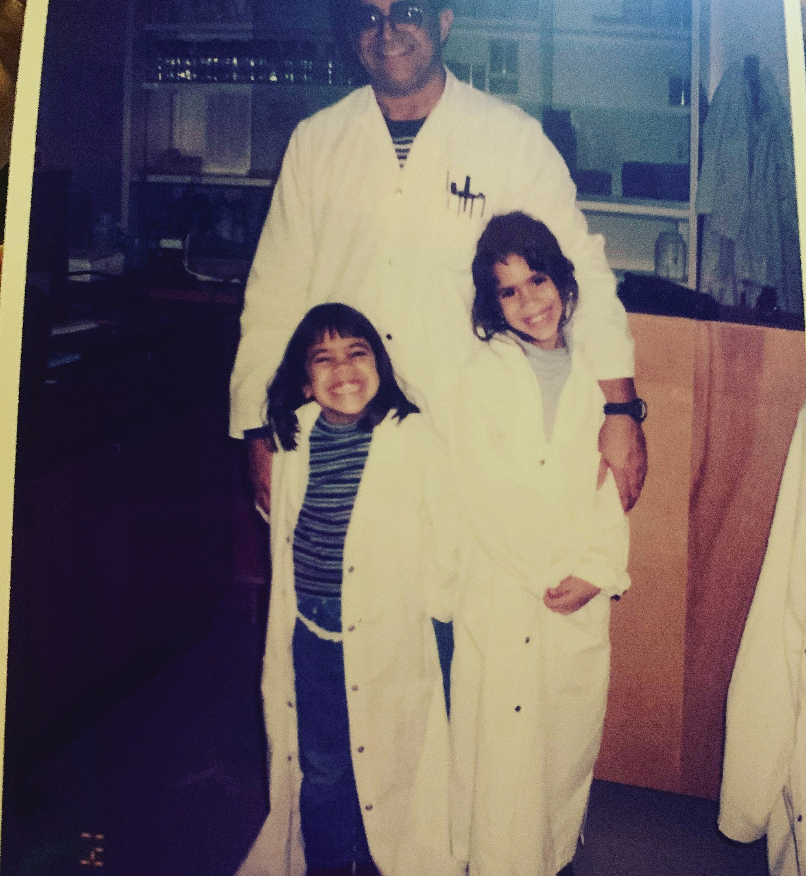
HOW DID NATALIA BECOME A GENE EDITOR?
“As a child, I was heavily involved in music and the performing arts to the extent that I contemplated becoming an opera singer! But I was also very intrigued in science and biology, which maybe started when my parents got me a red microscope for my 7th birthday. As I grew older, the more fascinated I became with the new discoveries in biology and music became more of a hobby.”

Slide 14
WHO OR WHAT INSPIRED NATALIA TO BE A SCIENTIST?
“I was exposed to science from a young age through my father who is a physiologist and had a research lab of his own. As a kid, I would spend time in his lab, wanting to play and experiment with all the interesting things in there. I became fascinated by the concept of experimentation to find results to questions and it opened the door of understanding that there was an infinite number of things that we had no answers to, and that it was through science that those answers would be found. As I grew older, and the more I learned biology in school, the more molecular biology and genetics appealed to me.”

Slide 15
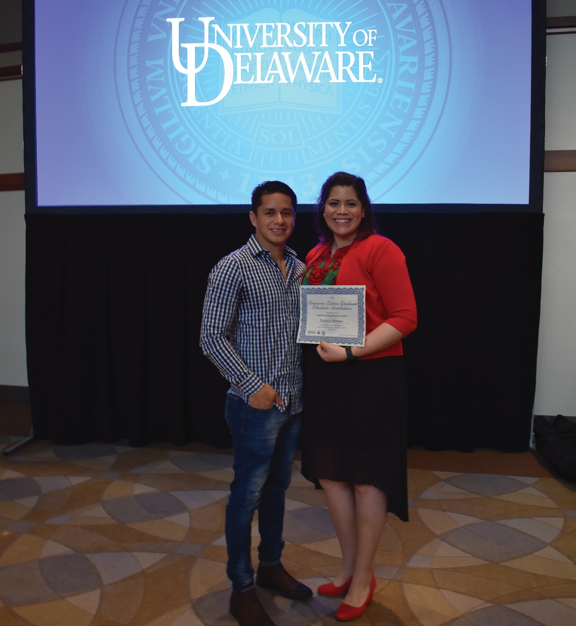
WHAT HAS MADE NATALIA SUCCESSFUL AS A SCIENTIST?
“I am a hard worker who is passionate about the projects I take on – I like to see them completed, regardless how challenging they might be. I am not afraid to learn new techniques and am aware I do not know everything; I recognise what I am not so good at and am open to asking for help and collaborating with people who are better in those areas. I also consider myself humble and approachable to those around me who might need assistance.”

Slide 16
WHAT IS NATALIA’S PROUDEST CAREER ACHIEVEMENT?
“The day I successfully defended my PhD thesis – that was a major life accomplishment!
Publishing my first paper as a first author was also a highlight.”

Slide 17
NATALIA’S TOP TIPS
Your career pathway will be challenging at times but see these challenges as an opportunity to grow and overcoming them will be easier. Remember: failures are learning moments!
Try to be yourself, at all times. Your perspective on things is unique to you and that can be extremely beneficial to your critical thinking skills.
Look out for – and actively pursue – any opportunities to get involved in research from an early stage of your career. It will always help your future.

Slide 18
TALKING POINTS
Natalia recommended subjects that could lead to a career in gene editing. What do you know about each of these subjects?
What is the difference between cellular biology and molecular genetics? If you don’t know, how could you find out?
What fascinated Natalia about science when she was younger? To what extent do you feel the same?

Slide 19
TALKING POINTS
How does Natalia describe herself? Do you share any of the characteristics she highlights?
How would you feel completing a successful PhD thesis or publishing a scientific paper? Can you put into words how that might feel?
Which of Natalia’s tips do you find most useful and why?

Slide 20
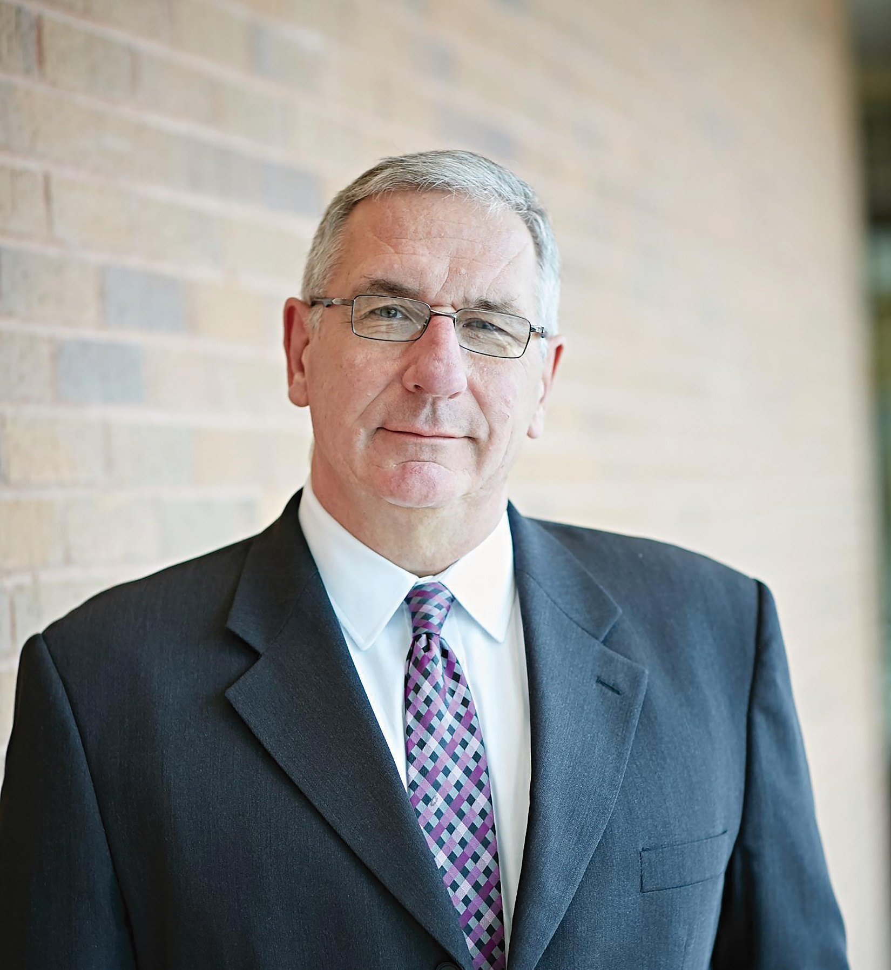
MEET NATALIA’S COLLEAGUES AT CHRISTIANACARE’S GENE EDITING INSTITUTE:
“Now is the most exciting time to be a geneticist and for young people to choose to study gene editing. With the molecular toolbox created by our generation, and the imagination and computational skill set of our younger generations, the possibilities are simply endless. Excellent technological developments, with a serious dose of humanity and ethics, is what the next generation will have to deal with, but I am confident they will do so intelligently.”
Dr Eric Kmiec
Founder and Director of ChristianaCare’s Gene Editing Institute.

Slide 21
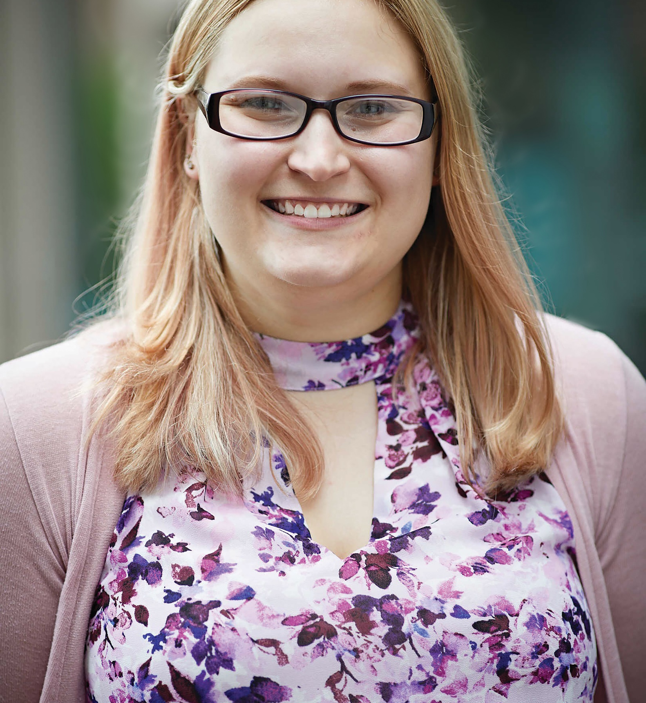
MEET NATALIA’S COLLEAGUES AT CHRISTIANACARE’S GENE EDITING INSTITUTE:
“My role is to listen in to all the research being done in the lab and then think about ways that this high-level science could be converted into curriculum for students at any level. This includes materials as well as potential laboratory exercises.
The most challenging and rewarding part of this is definitely taking the complicated science and making it understandable and accessible to students and the general public.”
Kristen Pisarcik
Research Assistant and Science Educator at ChristianaCare’s Gene Editing Institute.

Slide 22
TALKING POINTS
What makes Eric so optimistic about what could be achieved by the next generation of gene editors?
What are the challenges and rewards of Kristen’s job?
A range of people at different stages of their careers work at the Gene Editing Institute. How do you think this adds to the positive working community? How would you feel about working somewhere like the Gene Editing Institute?

Slide 23
MORE RESOURCES
THE GENE REVOLUTION: CHANGING HUMAN NATURE
The BBC has a fascinating documentary about CRISPR and what it might mean for human evolution. It is almost 90 minutes long, but it is well worth watching to get a broad understanding of CRISPR and what it might enable in the future.
GENETIC ENGINEERING WILL CHANGE EVERYTHING FOREVER
There is a much shorter video on YouTube that describes some of the potential ramifications of CRISPR.
ARE YOU BASED IN THE US?
This National Human Genome Research Institute website serves as a great starting point for you to learn more.

Slide 24
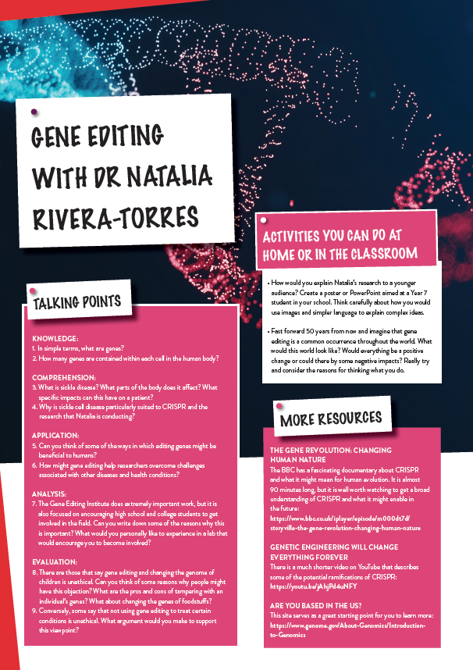
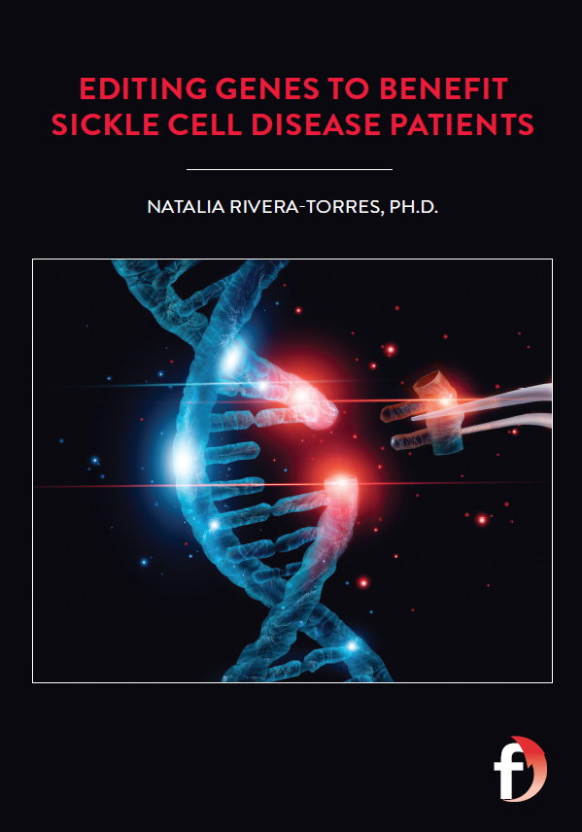
Dig deeper into Natalia’s research.
Download her activity sheet.

Slide 25
